Slide 1
Possible Field Dependence of Superconducting Properties in N-Doped Cavities
Dan Gonnella
Cornell University
December 1, 2015

Slide 2
Outline
Deconvolution of R_{res} and R_{BCS}
Fitting of field dependent data:
Exponential fitting
BCS fitting with SRIMP
Fitting with Xiao code
Magnetic Field Studies
Conclusions

Slide 3
Outline
Deconvolution of R_{res} and R_{BCS}
Fitting of field dependent data:
Exponential fitting
BCS fitting with SRIMP
Fitting with Xiao code
Magnetic Field Studies
Conclusions

Slide 4
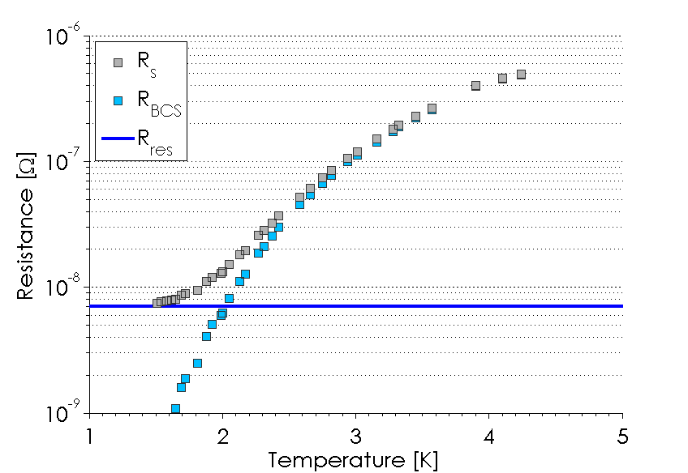
Surface Resistance
R_{BCS} can be approximated as an exponential

Slide 5
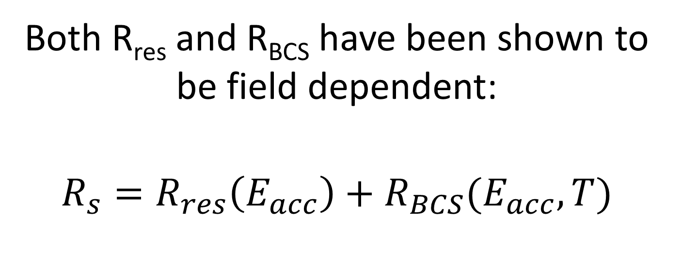
Deconvolution of R_{res} and R_{BCS}
Both R_{res} and R_{BCS} have been shown to be field dependent:
$$R_{s}=R_{res}\left(E_{acc}\right)+R_{BCS}(E_{acc},T)$$

Slide 6
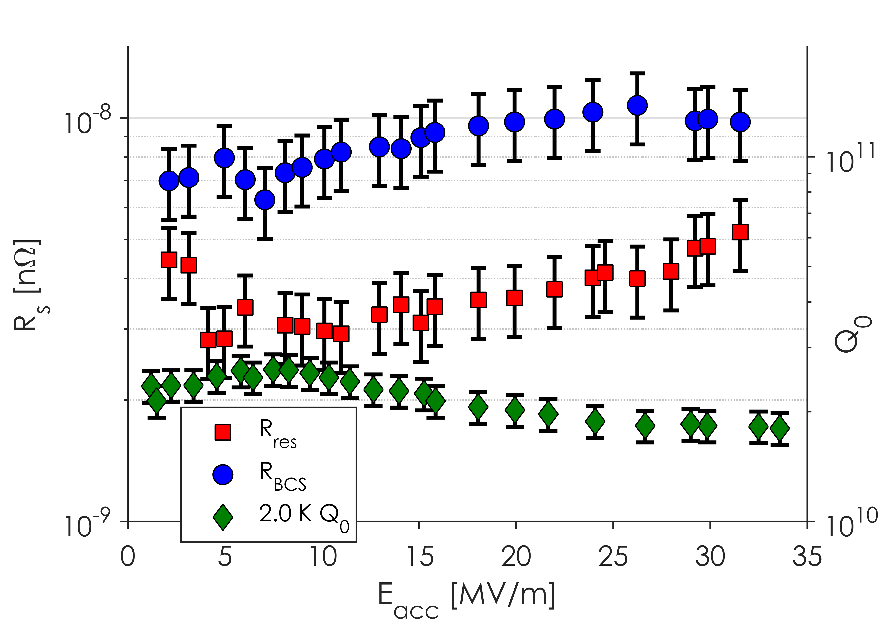
Deconvolution in 120ºC Cavities
Medium Field Q Slope
Medium field Q slope caused by a combination of increasing residual and BCS resistances in 120ºC baked cavities

Slide 7
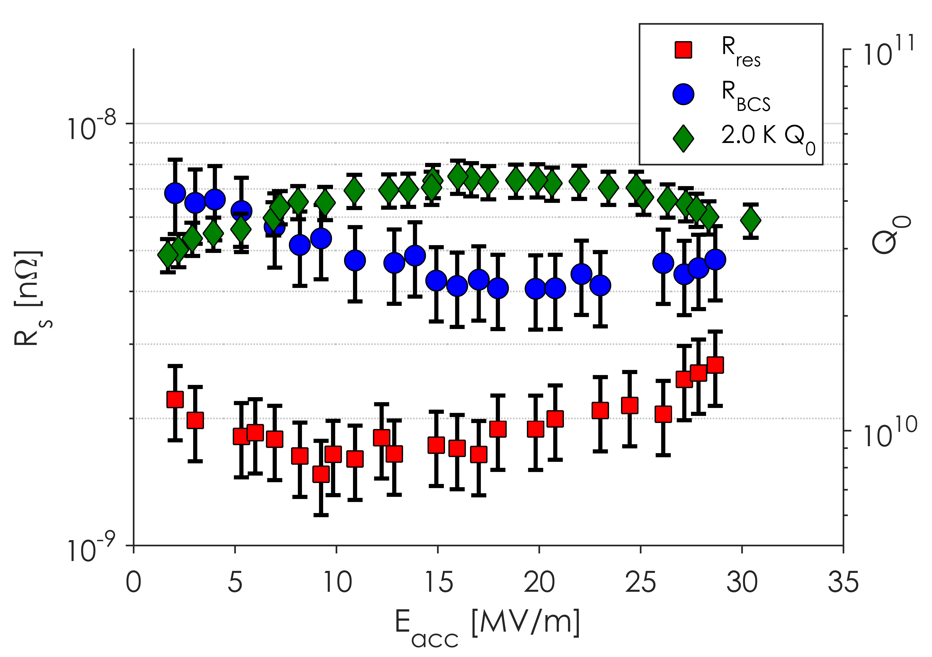
Deconvolution in N-Doped Cavities
Anti-Q Slope
Anti-Q slope caused by a decreasing BCS resistance in N-Doped Cavities

Slide 8
Outline
Deconvolution of R_{res} and R_{BCS}
Fitting of field dependent data:
Exponential fitting
BCS fitting with SRIMP
Fitting with Xiao code
Magnetic Field Studies
Conclusions

Slide 9
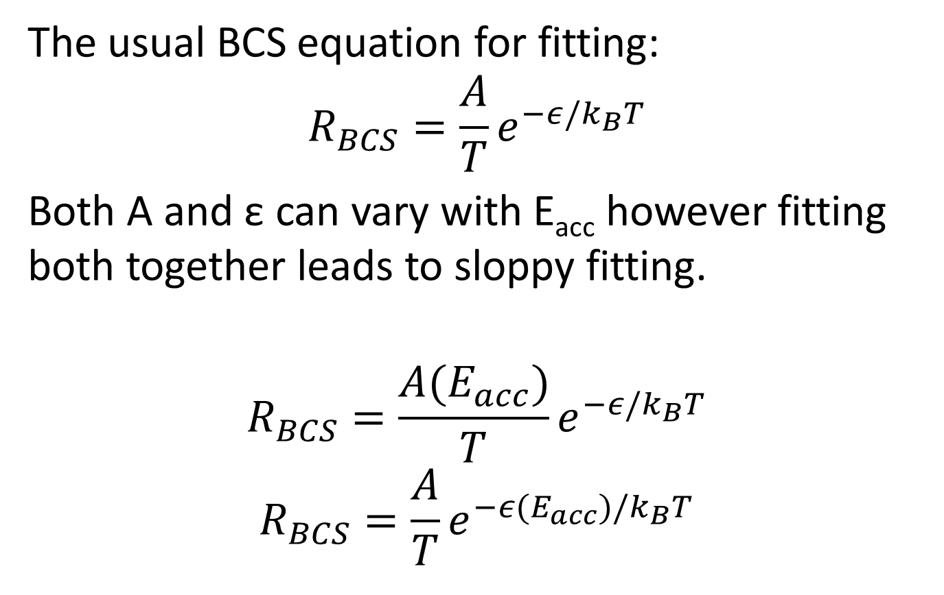
Exponential Fitting
The usual BCS equation for fitting:
$$R_{BCS}=\frac{A}{T}e^{−ε/k_{B}T }$$
Both A and ε can vary with E_{acc} however fitting both together leads to sloppy fitting.
$$R_{BCS}=\frac{A(E_{acc})}{T}e^{−ε/k_{B}T }$$
$$R_{BCS}=\frac{A}{T}e^{−ε(E_{acc})/k_{B}T }$$

Slide 10
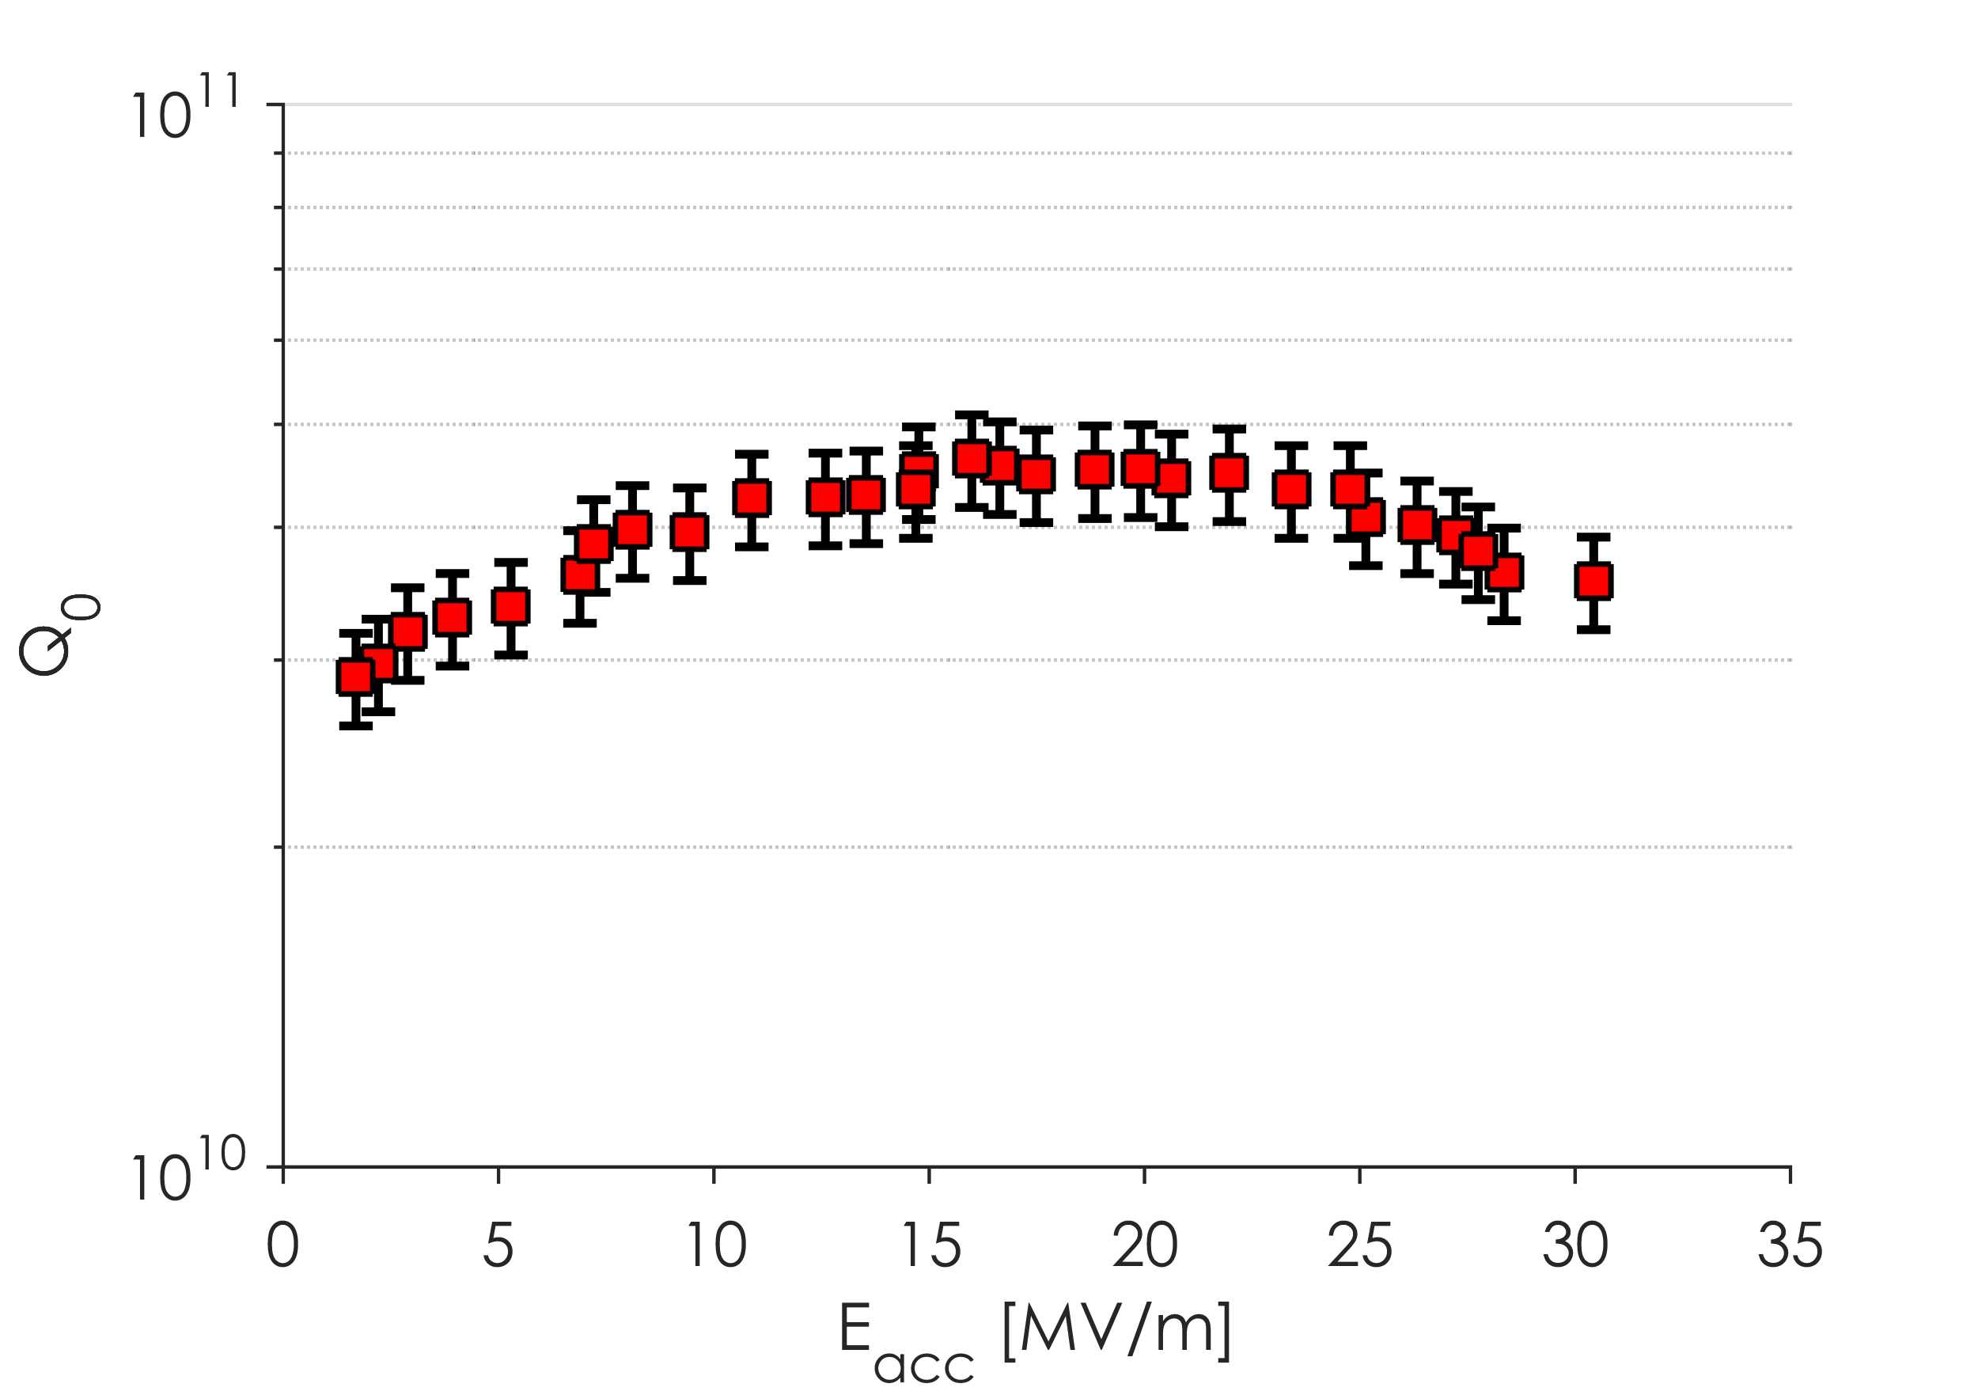
Cavity LT1-3
1.3 GHz Single Cell ILC shaped cavity: bulk VEP, 800ºC bake in vacuum for 3 hours, 20 min in 60 mTorr of N₂ for 20 minutes, 30 minute anneal, 12 µm VEP

Slide 11
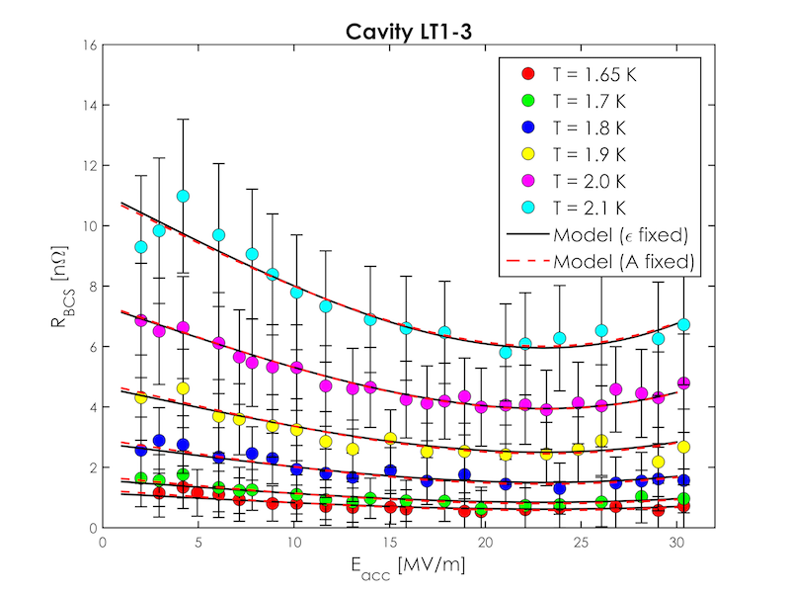
Exponential Fitting
Both models can fit the R_{BCS} data well in the anti-Q slope region

Slide 12
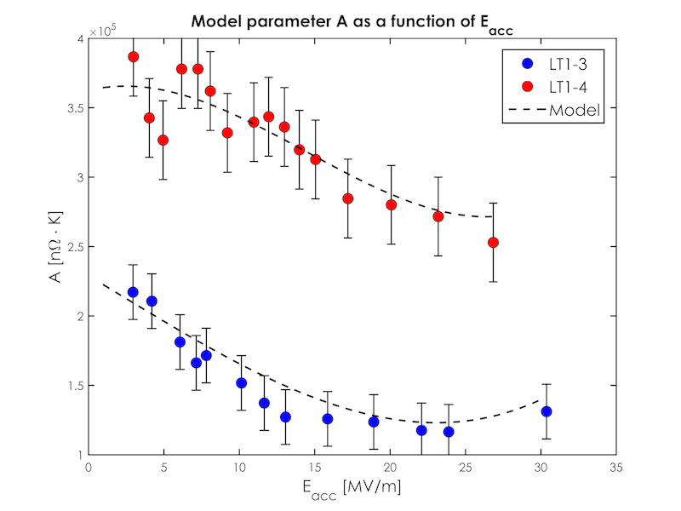
Exponential Fitting

Slide 13
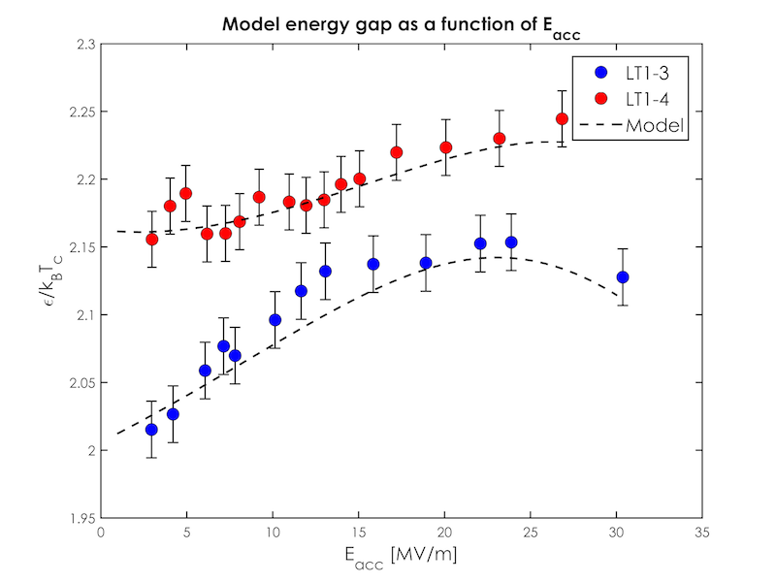
Exponential Fitting

Slide 14
Exponential Fitting
Fits with both A and ε field dependent are sloppy
Individual fits however can fit R_{BCS} vs E_{acc} data very well
A decreasing A with field or an increasing ε can explain the anti-Q slope observed in N-doped cavities

Slide 15
Outline
Deconvolution of R_{res} and R_{BCS}
Fitting of field dependent data:
Exponential fitting
BCS fitting with SRIMP
Fitting with Xiao code
Magnetic Field Studies
Conclusions

Slide 16
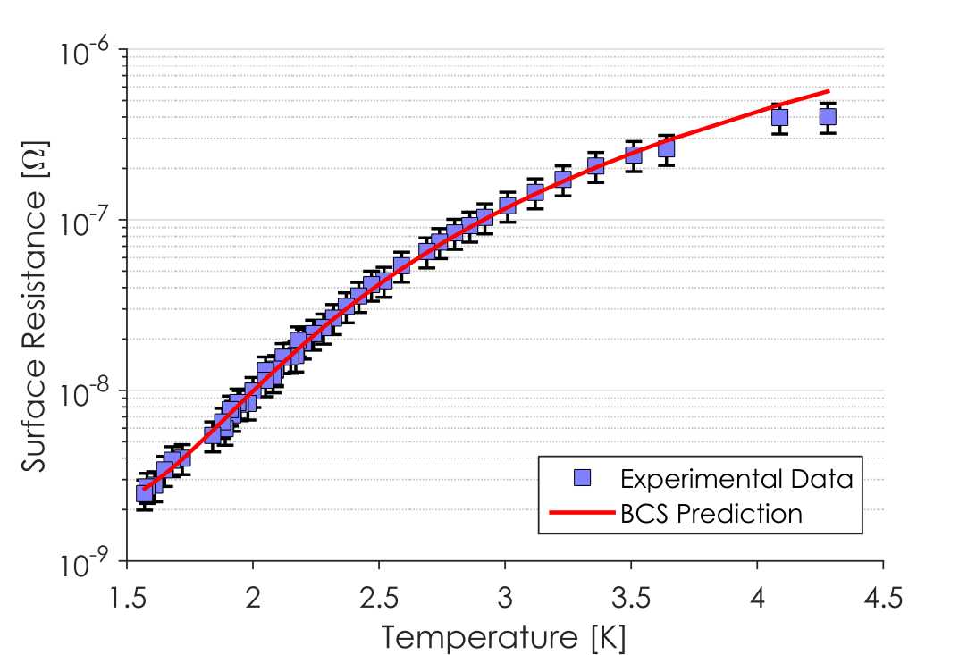
BCS Fitting with SRIMP
SRIMP, a code written by Halbritter, can be used to calculate R_{BCS} based on material parameters
T_{c}, Mean Free Path, ε/k_{B}T_{c}, coherence length, and penetration depth
Low Field Fit of Q vs T

Slide 17
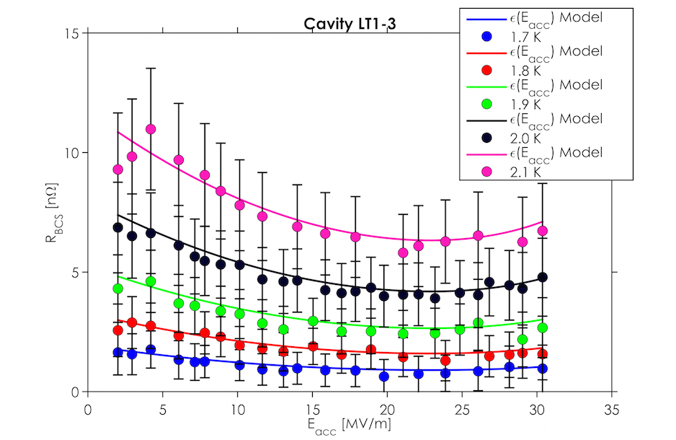
BCS Fitting with SRIMP

Slide 18
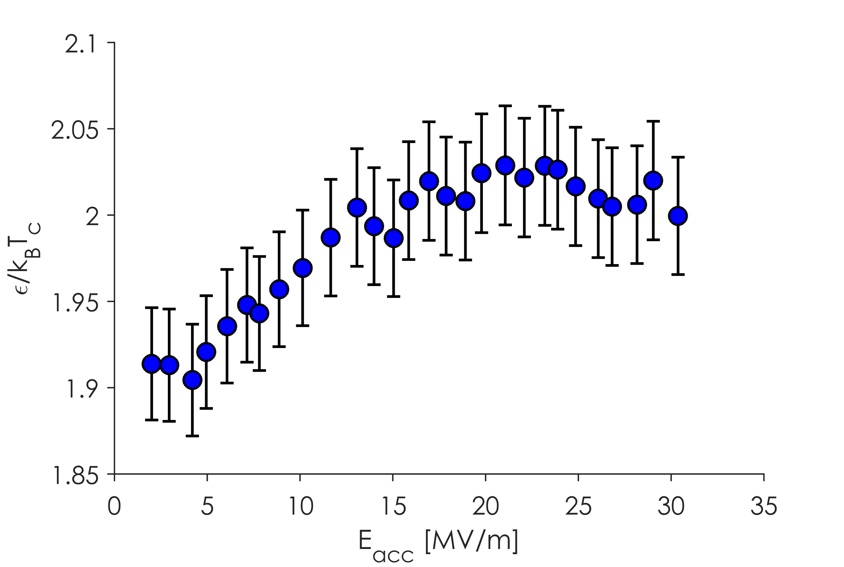
BCS Fitting with SRIMP
Energy Gap vs E_{acc}
Increasing Gap in the Medium Field Region

Slide 19
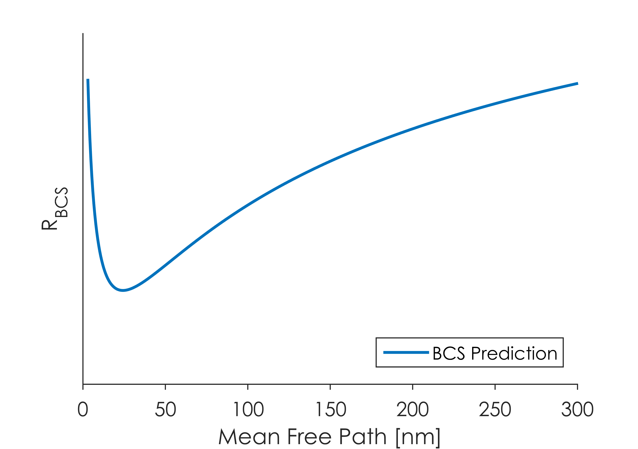
BCS Fitting with SRIMP
R_{BCS} vs Mean Free Path

Slide 20
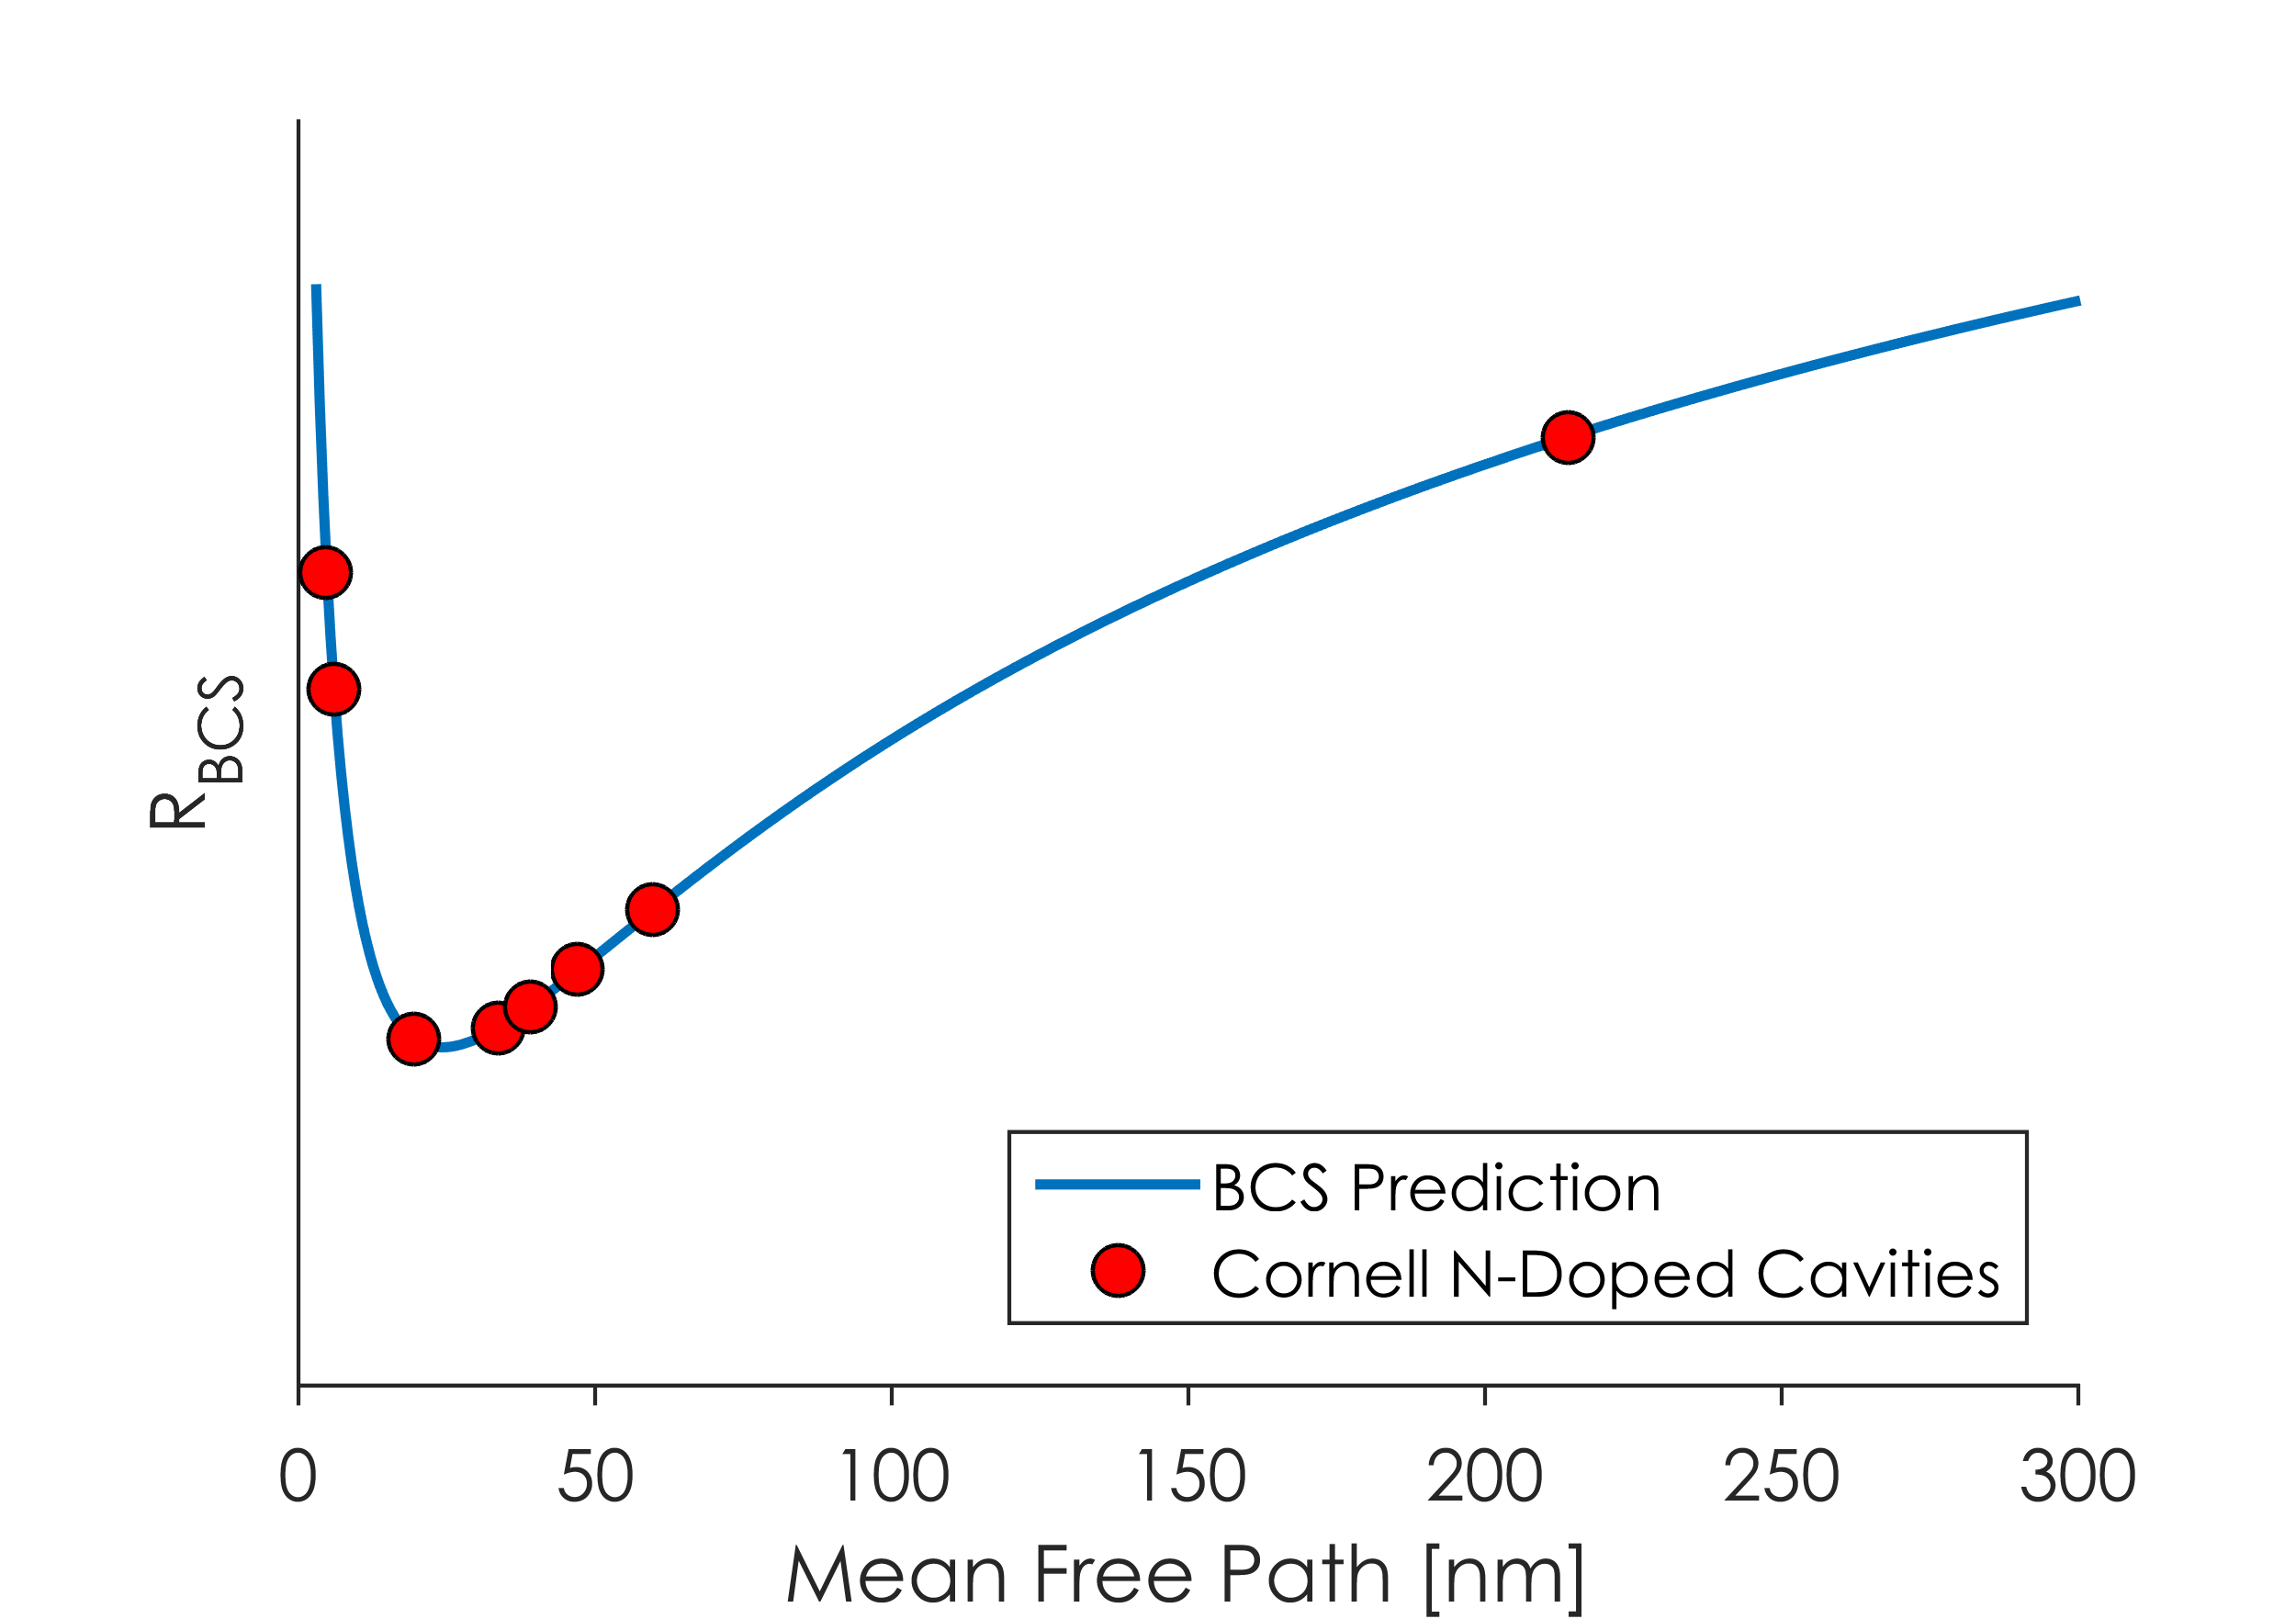
BCS Fitting with SRIMP
R_{BCS} vs Mean Free Path
N-Doped cavities are on both sides of the R_{BCS} vs Mean free path minimum
Increasing or decreasing mean free path with field alone cannot explain the anti-Q slope

Slide 21
BCS Fitting with SRIMP
Field dependence of BCS resistance in N-Doped cavities is related to the energy gap
Nitrogen-doped cavities have mean free paths that are on both sides of the R_{BCS} vs mean free path minimum
An increasing or decreasing mean free path with accelerating field cannot explain a decreasing BCS resistance in all cavities

Slide 22
Outline
Deconvolution of R_{res} and R_{BCS}
Fitting of field dependent data:
Exponential fitting
BCS fitting with SRIMP
Fitting with Xiao code
Magnetic Field Studies
Conclusions

Slide 23
Fitting with Xiao Code
Xiao et. al. developed a code to include field dependence in BCS theory using an extension of Mattis-Bardeen theory
Using low field material parameters obtained from SRIMP fitting, the full field dependence of the BCS resistance can be computed at different temperatures
B. P. Xiao et. al. Superconducting surface resistance under radiofrequency field. Physica C, 490(0):26–31, 2013.

Slide 24
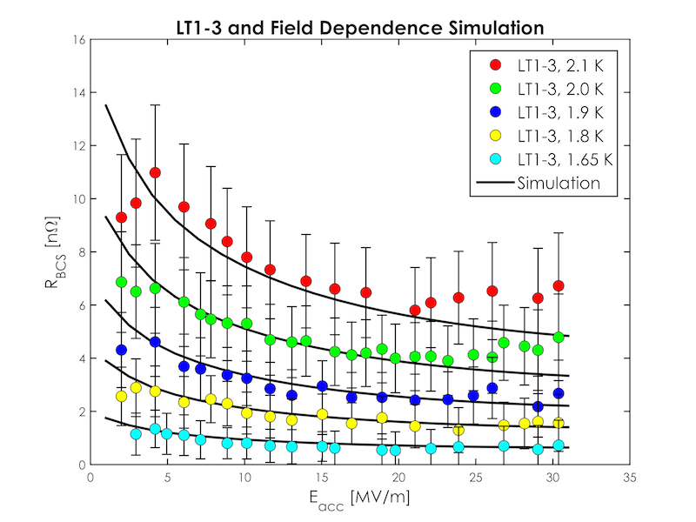
Fitting with Xiao Code
Good agreement at medium fields

Slide 25
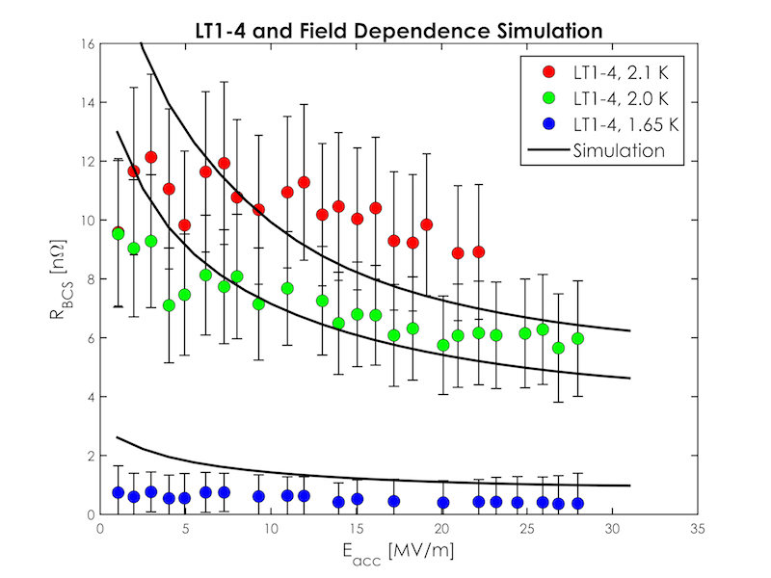
Fitting with Xiao Code
Poor agreement at medium and high fields

Slide 26
Fitting with Xiao Code
Xiao code can accurately predict behavior of BCS resistance at medium fields in Nitrogen-doped cavities
Theory deviates from observed behavior at low fields:
The theory predicts a much more drastic increase in BCS resistance than we observe

Slide 27
Outline
Deconvolution of R_{res} and R_{BCS}
Fitting of field dependent data:
Exponential fitting
BCS fitting with SRIMP
Fitting with Xiao code
Magnetic Field Studies
Conclusions

Slide 28
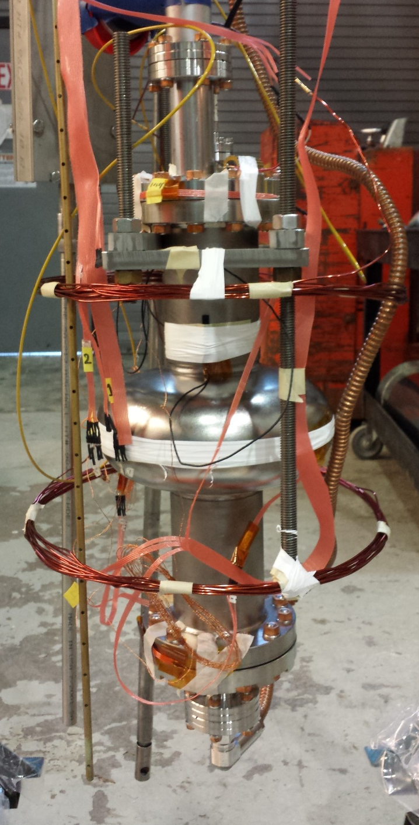
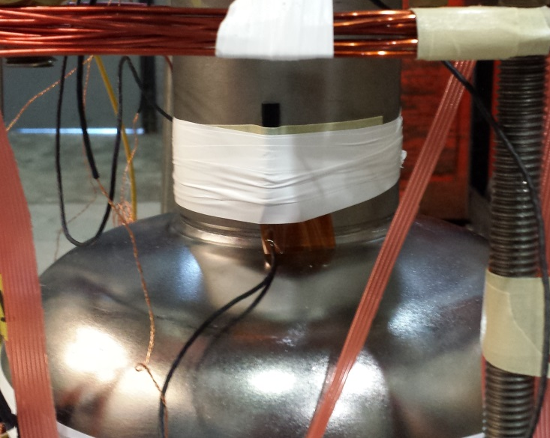
Flux Trapping Studies
Slow Cool
Down System
Temperature Sensors
Fluxgate
Magnetometer
Helmholtz
Coil

Slide 29
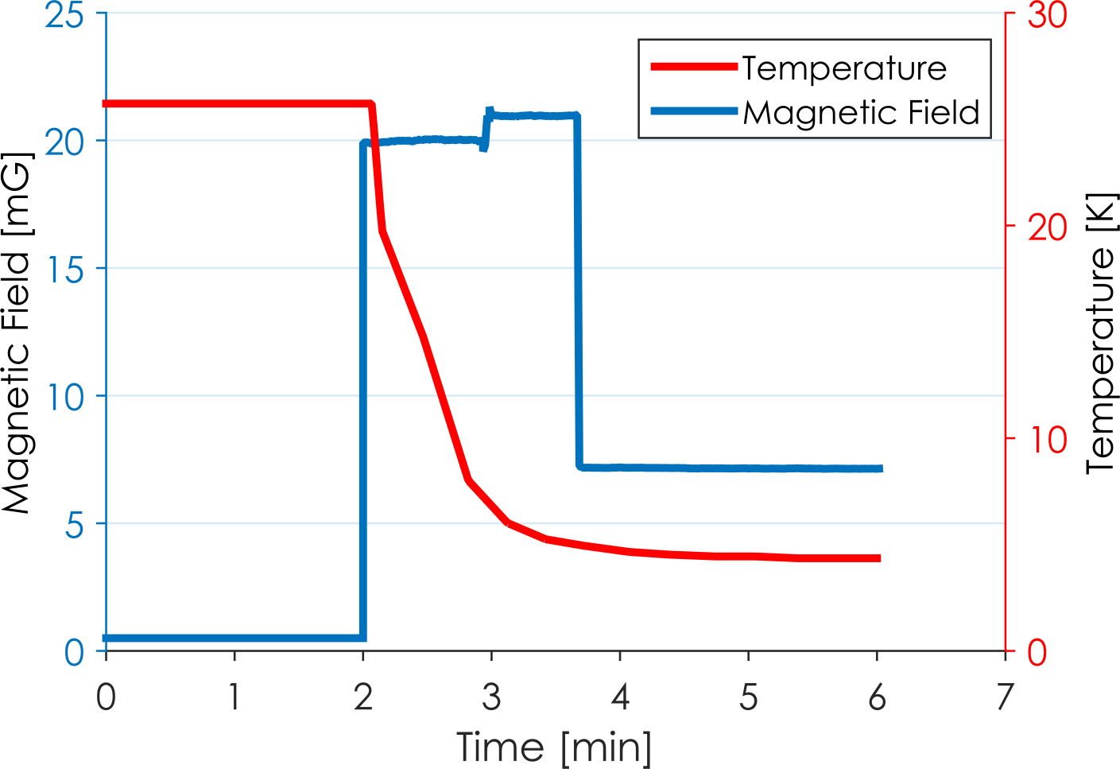
Fluxgate Measurements
External Field On
T_{C}
External Field Off,
Flux Trapped
External Field Off

Slide 30
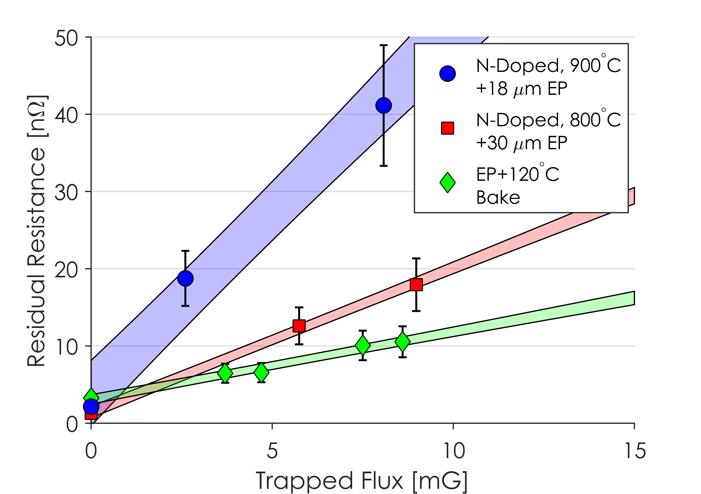
Sensitivity to Trapped Magnetic Flux
A total of 10 cavity preparations were tested, each with different mean free paths – N-doping gives us the tools needed to finely tune the mean free path

Slide 31
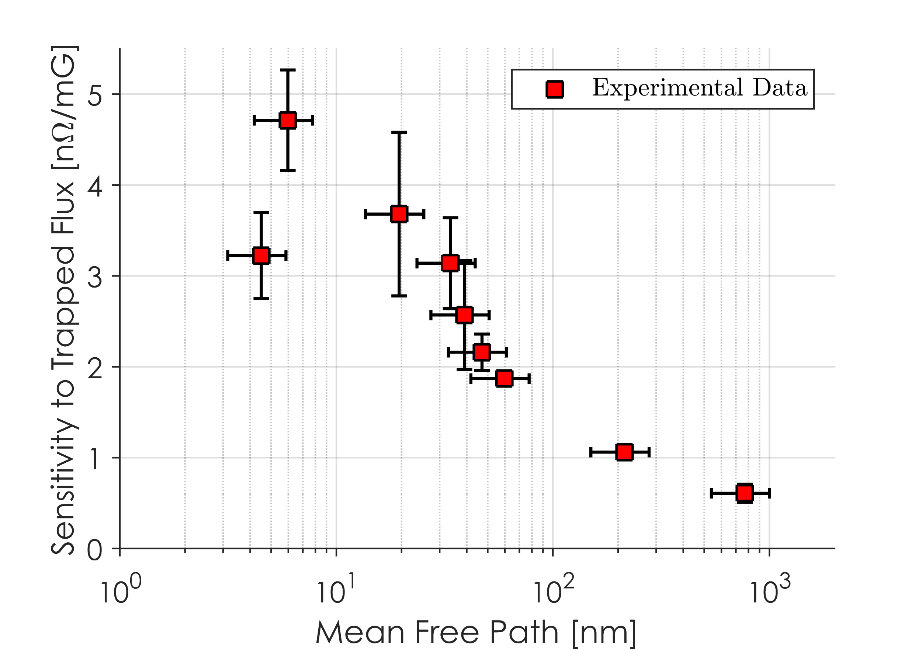
Sensitivity to Trapped Magnetic Flux
In the clean limit, longer mean free path leads to lower sensitivity of R_{res} to trapped magnetic flux
In the dirty limit, shorter mean free path leads to lower sensitivity
See our paper on ArXiV for full details: Gonnella et. al. arXiv:1509.04127
Notes:
At low mfp, mean spacing between pinning sites decreases so sensitivity decreases. At high mean free paths, mean spacing no longer plays a roll so losses go as 1/mfp^1/2

Slide 32
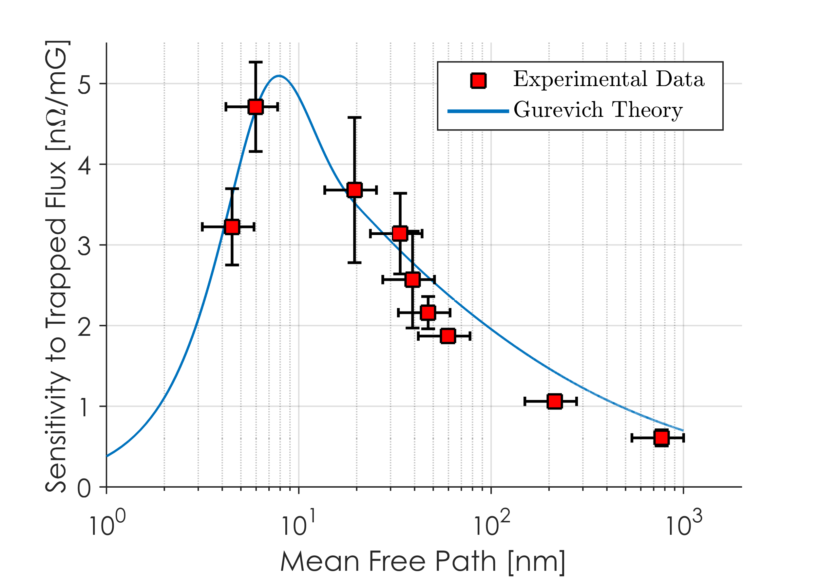
Sensitivity to Trapped Magnetic Flux
H(t)
u(z,t)
2ξ
l
λ
See our paper on ArXiV for full details: Gonnella et. al. arXiv:1509.04127
This is well described by theoretical predictions proposed by Alex Gurevich (Physical Review B, 87(5):054502, 2013.)
This model is heavily dependent upon mean spacing between pinning sites: we assume a linear relationship between this mean free path
Notes:
At low mfp, mean spacing between pinning sites decreases so sensitivity decreases. At high mean free paths, mean spacing no longer plays a roll so losses go as 1/mfp^1/2

Slide 33
Outline
Deconvolution of R_{res} and R_{BCS}
Fitting of field dependent data:
Exponential fitting
BCS fitting with SRIMP
Fitting with Xiao code
Magnetic Field Studies
Conclusions

Slide 34
Conclusions
Medium field Q slope in 120ºC cavities is caused by a combination of increasing BCS and residual resistances
Anti-Q slope in Nitrogen-doped cavities is caused purely by decreasing BCS resistance
This anti-Q slope can be explained in a variety of ways: decreasing A or increasing ε in exponential fitting and increasing ε/k_{B}T_{c} in full BCS fitting
Changing mean free path cannot solely explain the anti-Q slope since low field mean free paths are on either side of the minimum in N-Doped cavities

Slide 35
Conclusions
Xiao code, a field-dependent derivation of Mattis-Bardeen theory can accurately predict BCS resistance at medium fields from low field material parameters but fails at low fields
Losses due to ambient magnetic fields are heavily dependent on mean free path and are very well explained by Gurevich’s theory of vortex oscillations

